Slide 1
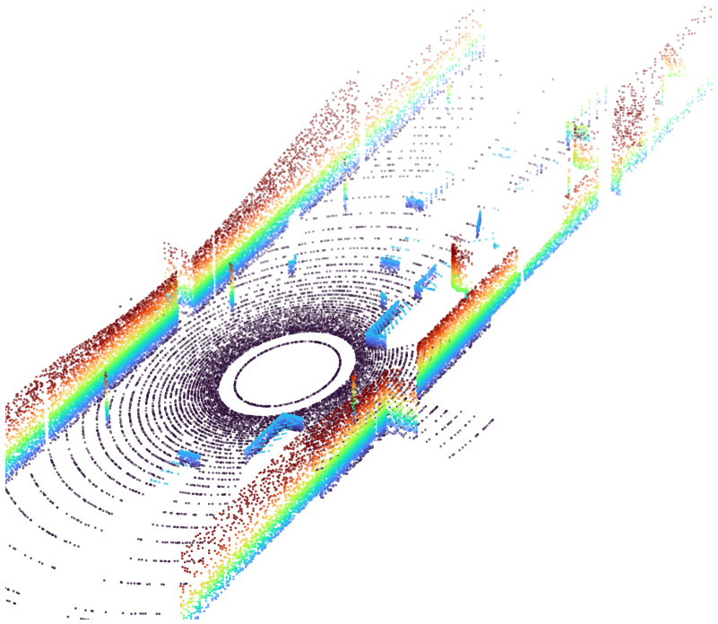
L5 LiDAR Perception
Zonghua Gu | Fall 2026
Notes:
Two-lecture module (about 150 minutes). Lecture A: LiDAR fundamentals and point cloud data (slides 4-22). Lecture B: classical point cloud perception and deep-learning perception (slides 23-48). Title image: synthetic 128-channel scan rendered by ray casting (original figure).

Slide 2
Roadmap and Learning Outcomes
Part 1
Part 2
Part 3
Part 4
LiDAR Fundamentals
ToF ranging, scanning, wavelength, weather
Lecture A | ~35 min
Point Cloud Data
Frames, calibration, representations, datasets
Lecture A | ~30 min
Classical Perception
Ground removal, clustering, boxes, ICP, tracking
Lecture B | ~35 min
Deep Learning Perception
PointNet, voxels, pillars, BEV, fusion, metrics
Lecture B | ~40 min
After these two lectures you should be able to:
1. Explain how a LiDAR measures range and why point clouds are sparse, noisy, and range-dependent
2. Transform points between sensor, vehicle, and world frames and compensate motion distortion
3. Build and critique a classical pipeline: ground removal, clustering, box fitting, tracking
4. Compare point-, voxel-, pillar-, and BEV-based 3D detectors and read their metrics
Notes:
Frame the two lectures. Part 1-2 are about how the data is produced; Part 3-4 about how it is turned into objects. Estimated time: Part 1 35 min, Part 2 30 min (lecture A); Part 3 35 min, Part 4 40 min (lecture B).

Slide 3
Where LiDAR Fits in the AV Stack
Sensors
LiDAR, camera, radar, GNSS/IMU
Perception
detect, segment, track
Localization
map matching, HD map
Prediction
future motion of agents
Planning
route, behavior, trajectory
Control
steer, throttle, brake
today's focus
• LiDAR gives direct 3D geometry: centimeter-level range, independent of ambient light
• Output of perception is a list of 3D boxes with class, heading, velocity, and track ID
• The same list feeds localization (map matching), prediction, and planning
• Today: how pulses become points, and how points become objects
• Builds on L1.2 (sensor overview) and the 2D detection lecture; links forward to adversarial attacks
Notes:
Recall L1.2: LiDAR is the active range sensor with precise 3D geometry. Today's focus is the first two boxes. Point out that the same perception output (3D boxes + tracks) is what prediction and planning consume.

Slide 4
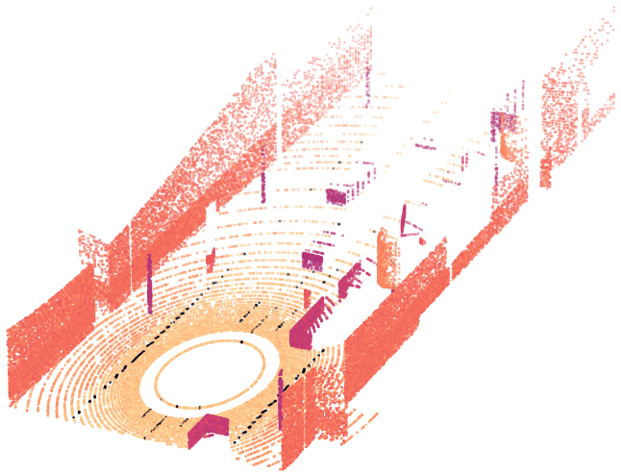
Part 1: LiDAR Fundamentals
Time of flight | coordinates | scanning | wavelength | reflectivity | weather | data rate
Notes:
Section divider. About 35 minutes for Part 1.

Slide 5
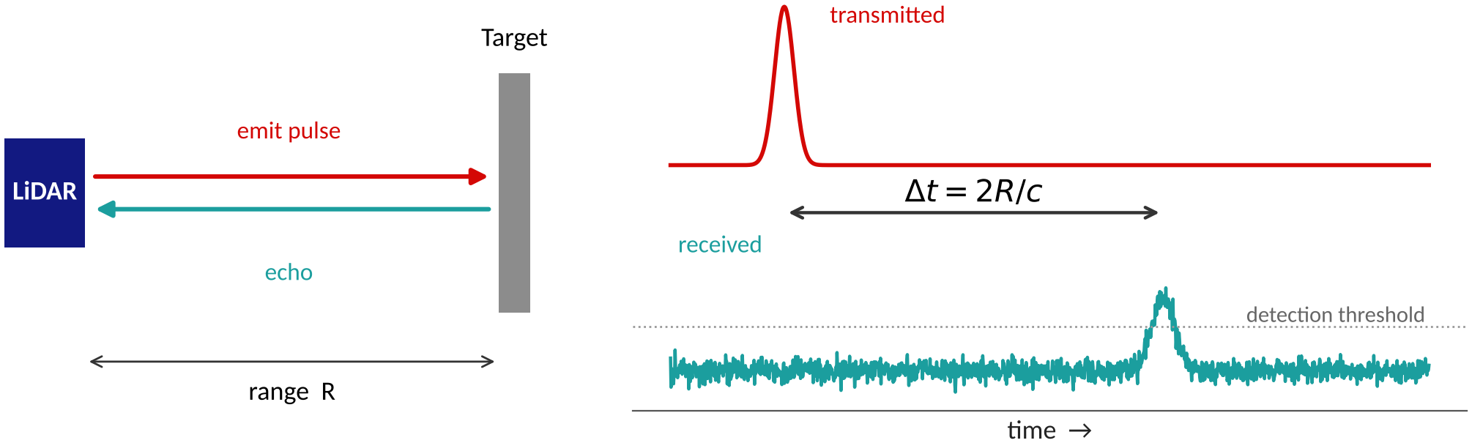
Time-of-Flight Ranging
A pulse leaves the laser at t = 0, hits a surface, and a fraction returns
Range from the round-trip time: R = c · Δt / 2 (c ≈ 3×10⁸ m/s)
Rule of thumb: 1 ns of timing ≈ 15 cm of range; 5 cm accuracy needs ≈ 0.33 ns timing
A 200 m target returns after 2·200 / c ≈ 1.33 µs
Per-channel pulse rate is limited by the echo wait: f ≤ c / 2R_max (≤ 750 kHz for 200 m)
Original figure (synthetic waveform). Pulsed ToF as used by most automotive LiDARs; see also Waymo, ISSW 2024.
Notes:
Derive R = c*dt/2. Use the rule of thumb 1 ns = 15 cm of range (30 cm round trip). Ask: how precisely must the receiver timestamp the echo for 5 cm accuracy? (0.33 ns). Pulse repetition limits unambiguous range.

Slide 6
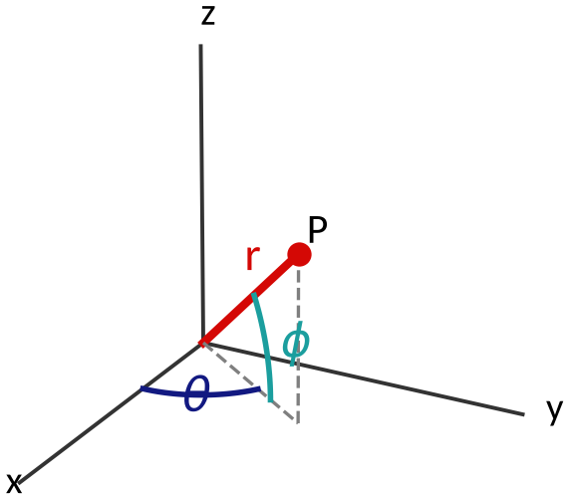
From Measurement to 3D Point
Raw return: (r, θ, φ, intensity, t)
θ = azimuth (encoder / scan angle), φ = elevation (fixed per channel)
  x = r cos φ cos θ
  y = r cos φ sin θ
  z = r sin φ
Inverse: r = √(x² + y² + z²), φ = asin(z / r), θ = atan2(y, x)
In the sensor frame z points up: the road is near z ≈ −(mounting height)
Angular errors matter: 0.1° at 100 m is already ≈ 0.17 m laterally
Original figure.
Notes:
Each return is (r, azimuth, elevation, intensity, timestamp). The azimuth comes from the encoder / scan position, the elevation from the channel. Convert to Cartesian for processing. Z is up in the sensor frame, so ground is roughly at minus the mounting height.

Slide 7
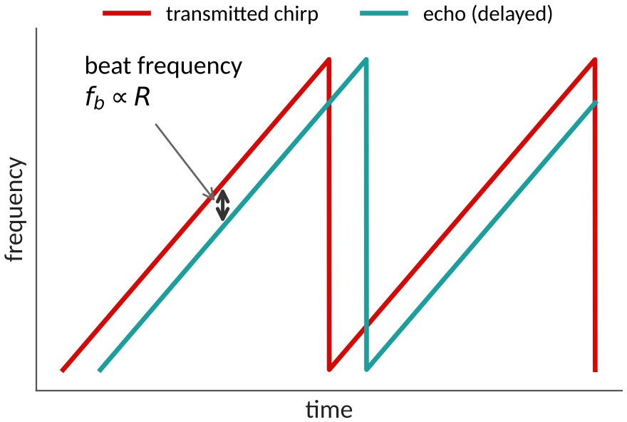
Pulsed ToF vs. FMCW LiDAR
 | Pulsed ToF | FMCW
Measures | Round-trip time of a short pulse | Beat frequency of chirp vs. echo
Velocity | Not direct (from frame-to-frame motion) | Direct radial velocity via Doppler
Detection | Incoherent, intensity threshold | Coherent; robust to other LiDARs and sunlight
Wavelength | 905–940 nm or 1550 nm | Typically 1550 nm
Maturity | Mass-produced, lower cost | Newer, complex photonics, higher cost
Examples | Hesai, Ouster, Luminar, Waymo | Aeva, Aurora
Beat frequency f_b is proportional to range R; the Doppler shift adds a velocity term.
Original figure (schematic). Comparison summarized from standard LiDAR references and vendor documentation.
Notes:
Most deployed automotive LiDAR is pulsed ToF. FMCW sends a frequency chirp and mixes the echo with a local copy; the beat frequency gives range and the Doppler shift gives radial velocity directly. FMCW is attractive for velocity and interference robustness but is harder to build.

Slide 8
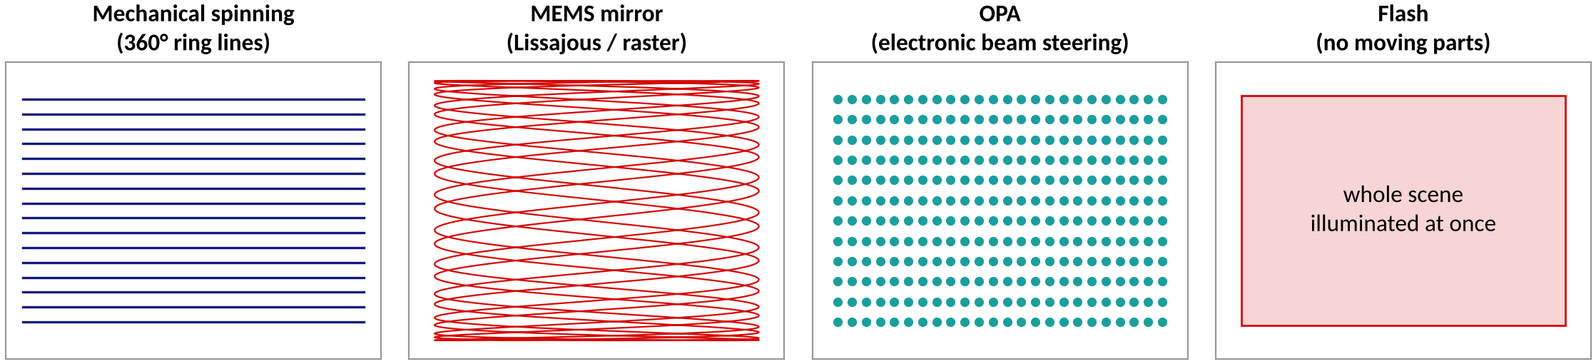
How the Beam Is Steered
Type | How it works | Strengths | Limits
Mechanical spinning | Rotating assembly sweeps 360° | Full FOV, mature, long range | Cost, size, moving parts
MEMS mirror | Oscillating micro-mirror | Compact, lower cost | Narrow FOV per unit, small aperture
Optical phased array | Electronic beam steering | No moving parts | Immature; limited range and FOV
Flash | Illuminate whole scene at once | Simple, fast frame | Short range, low resolution
Original schematic figure; Waymo, 'Lidar and Autonomous Cars', ISSW 2024 (scan range vs. duty cycle).
Notes:
Four families. Mechanical spinning dominates robotaxis today. MEMS and OPA aim at lower cost and solid-state packaging. Waymo's ISSW 2024 talk contrasts a 60-degree scan range with 25% duty cycle against a 360-degree range with 100% duty cycle, arguing the latter gives the best field of view per dollar.

Slide 9
Resolution and Point Spacing
Spacing between neighboring points
s = R · tan(Δθ) ≈ R · Δθ
At Δθ = 0.2°:
• 0.17 m at 50 m
• 0.35 m at 100 m
• 0.70 m at 200 m
Beyond ≈ 143 m a 0.5 m pedestrian is hit by less than one beam per scan line
Finer Δθ means more points per second, more compute, more heat
Computed from s = R·tan(Δθ). Chart is native and editable.
Notes:
Worked example: s = R tan(delta theta). With 0.2 degree spacing, a pedestrian 0.5 m wide gets fewer than one sample per scan line beyond about 143 m. Waymo's long-range unit quotes 0.05 degree azimuth resolution at 200 m for exactly this reason.

Slide 10
Wavelength Choice: 905 nm vs. 1550 nm
 | ≈ 905–940 nm | ≈ 1550 nm
Source | Semiconductor diode lasers (edge emitters, VCSEL arrays) | Fiber or other 1550 nm lasers
Detector | Silicon APD / SPAD / SiPM (cheap, mature) | InGaAs APD (more expensive)
Eye safety | Light focuses on the retina → pulse energy is limited | Absorbed before the retina → higher pulse energy allowed
Range potential | Limited by eye-safe power; relies on sensitive detectors | Higher power budget helps long range
Atmosphere | Lower water absorption | Stronger water absorption
Cost / volume | Lower cost, widely used | Higher cost, fewer suppliers
Waymo, 'Lidar and Autonomous Cars', ISSW 2024 (SPAD PDE trend at 915 nm); general LiDAR references.
Notes:
Key trade-off: eye-safety limits the pulse energy, and the detector technology follows from the wavelength. Waymo reports SPAD photon detection efficiency improving from 5% to 40% at 915 nm over five years, which is why silicon at ~905 nm remains competitive.

Slide 11
Short-Range vs. Long-Range LiDARs
 | Short-range perimeter LiDAR | Long-range 360° LiDAR
Max range | ≈ 20 m | ≈ 200 m
Azimuth resolution | ≈ 0.5° | ≈ 0.05°
Listening time (check: 2R/c) | ≈ 0.13 µs | ≈ 1.3 µs
SPADs per instantaneous FOV | ≈ 10 | ≈ 1000
Role | Curbs, close pedestrians, blind spots | Highway speed, far vehicles, early warning
Waymo's vehicle combines four short-range perimeter LiDARs, one long-range 360° LiDAR, cameras, and radar; it designs its own pulsed-ToF sensors.
Waymo (S. Verghese), 'Lidar and Autonomous Cars', ISSW 2024.
Notes:
Ask students to verify the listening time from R: 2*20 m / c = 0.13 microseconds and 2*200 m / c = 1.33 microseconds. Long range needs high angular resolution and many SPADs per pixel for sensitivity; the short-range perimeter units trade range for coverage close to the car.

Slide 12
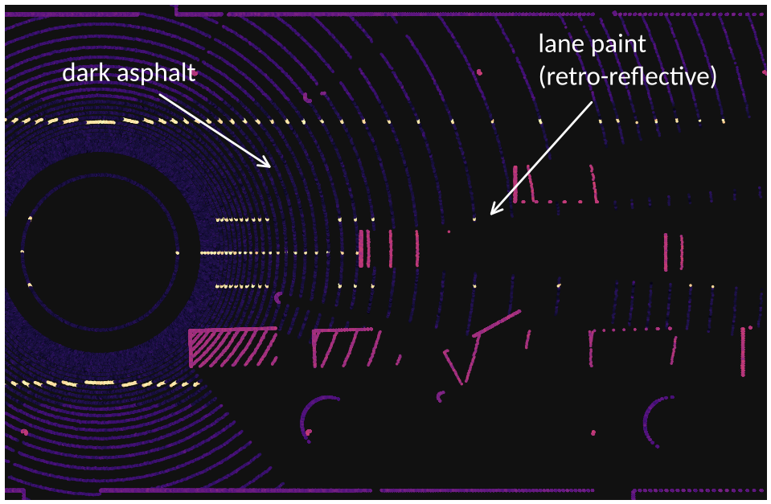
Reflectivity and Intensity
Return power depends on reflectivity, range (≈ 1/R²), incidence angle, wavelength
Diffuse dark targets (tires, asphalt) return < 5 %; retroreflectors (signs, lane paint) are 10–30+ dB brighter
Receiver needs a very high dynamic range: weak and strong echoes in the same sweep
Useful features: lane markings, sign detection, localization against intensity maps
Caveat: raw intensity is not a calibrated reflectance; normalize by range and angle
Synthetic scene colored by reflectivity (bright = high).
Waymo, ISSW 2024 (reflectivity and dynamic range); original synthetic figure.
Notes:
Intensity is a free feature: it separates lane paint and signs from asphalt. Dynamic range is the hard part: tires and asphalt are below 5% reflective, retroreflectors are 10-30 dB brighter, and a bright return can leak into neighbouring channels (blooming).

Slide 13
Weather and Window Contamination
Signal falls as exp(−2αR): the light travels out and back
Fog, rain, snow add attenuation and backscatter clutter (false droplet returns)
A dirty or wet window scatters light into neighboring channels
Waymo: detect > 200 m despite weather; use full-waveform sampling and adaptive thresholds
Practical filters: isolated low-intensity points, multi-return, cleaning and heating
Beer–Lambert model; α ≈ 3.91 / visibility (Koschmieder), illustrative values. Waymo, ISSW 2024.
Notes:
Beer-Lambert: P_rx falls as exp(-2 alpha R) because the light travels out and back. Koschmieder: alpha ~ 3.91/visibility. With 200 m visibility (dense fog), only 1.8% of the signal survives at 100 m. Waymo mitigates with full-waveform sampling and adaptive thresholds to separate droplet returns from hard targets.

Slide 14
Typical Failure Modes
Phenomenon | Cause | What you see in the point cloud | Typical mitigation
Specular / glass surfaces | Mirror-like reflection or transmission | Holes, or ghost points behind the surface | Multi-return, camera fusion
Very dark targets | < 5 % of photons return | Sparse or missing points on tires, black cars | Sensitive detectors, longer integration
Multipath / ghost points | Pulse bounces over two surfaces | Phantom points beyond walls and vehicles | Geometric consistency filters
Crosstalk and interference | Other LiDARs, sunlight | Noise points, phantom objects | Pulse coding, timing jitter, FMCW
Retroreflector blooming | Strong echo saturates receiver | Halo around signs and plates | Dynamic range, saturation handling
Compiled from Waymo ISSW 2024 and standard LiDAR references.
Notes:
Use this as a checklist when students debug a point cloud: missing points, ghost points, halos, noise. Each has a physical cause and a standard mitigation.

Slide 15
LiDAR Generates Big Data
2.3 M
37 MB/s
133 GB/h
points per second
(128 ch × 1,800 az × 10 Hz)
at 16 bytes per point
(x, y, z, intensity as float32)
from a single sensor,
before compression
• Several LiDARs per vehicle multiply the rate (Waymo Open Dataset records 5 LiDARs)
• Perception must run at the sweep rate (≥ 10 Hz): ≈ 100 ms budget end-to-end
• Hence the interest in compact representations (range image, pillars) and sparse operators
• Logging, upload, and labeling costs scale with data volume, not just compute
Computed from stated sensor parameters (illustrative). Waymo Open Dataset: Sun et al., CVPR 2020.
Notes:
Compute: 128 channels x 1,800 azimuth steps (0.2 degrees) x 10 Hz = 2.3 million points per second at most. At 16 bytes per point (x, y, z, intensity as float32) that is about 37 MB/s per sensor. A vehicle with several LiDARs multiplies this. Ties back to L1.2 'AV sensors generate big data'.

Slide 16
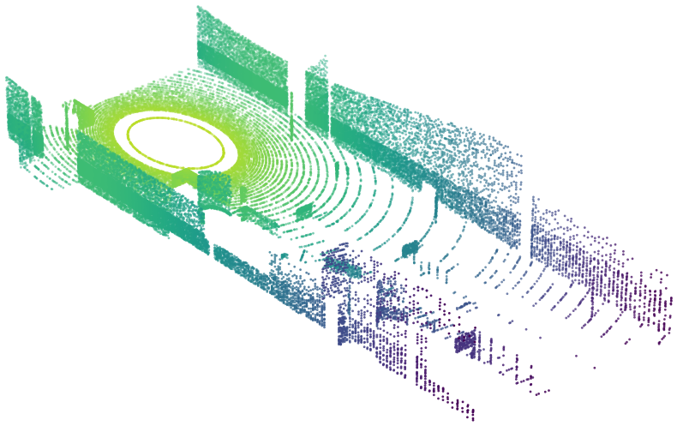
Part 2: Point Cloud Data
Properties | coordinate frames | motion distortion | representations | voxel sparsity | datasets
Notes:
Section divider. About 30 minutes for Part 2.

Slide 17
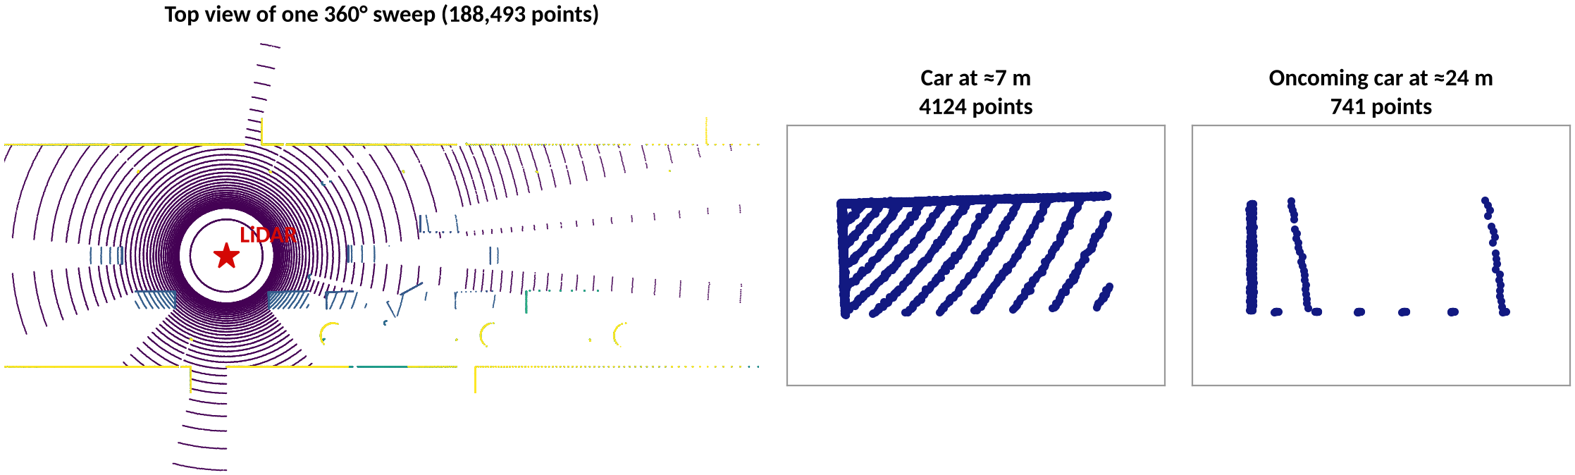
What Is a Point Cloud?
An unordered set of points {(x, y, z, intensity, t)}: no grid, no neighbor information
Density falls with range: ≈ 4,100 points on a car at 7 m, only ≈ 740 on an oncoming car at 24 m
Occlusion: only surfaces facing the sensor are sampled (the typical 'L-shape' of a car)
This synthetic 128-channel sweep has 188,493 returns; real sensors give 10⁵–10⁶ per sweep
Original synthetic scene (ray casting, 128 channels × 1,800 azimuth steps).
Notes:
Emphasize three properties that drive every algorithm later: it is a set (no order, no grid), density depends on range, and only visible surfaces are sampled. The numbers come from our synthetic 128-channel scene: one car at 7 m gets about 4,100 points, an oncoming car at 24 m gets about 740.

Slide 18
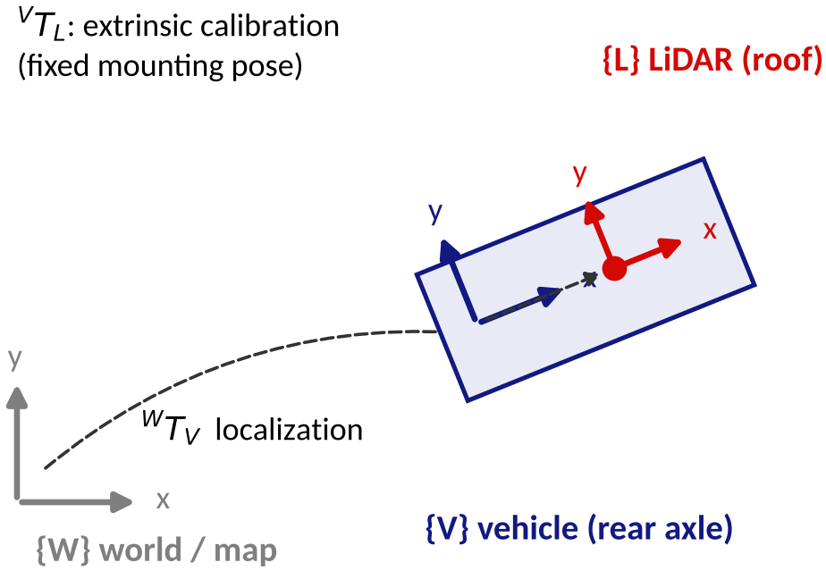
Coordinate Frames and Calibration
Points are measured in the LiDAR frame {L}; planning needs the vehicle {V} or world {W} frame
p_V = R · p_L + t (extrinsic calibration, fixed)
p_W = ᵂT_V · ᵛT_L · p_L (localization from GNSS / IMU / SLAM)
Camera fusion: λ [u v 1]ᵀ = K (R_c p_L + t_c)
A 0.5° rotation error shifts a point by ≈ 0.9 m at 100 m
Original figure.
Notes:
Walk through the chain: points are measured in the LiDAR frame, the extrinsic transform moves them to the vehicle frame, localization places the vehicle in the world. For camera fusion add the camera extrinsics and intrinsics K. tan(0.5 deg) x 100 m = 0.87 m: tiny rotation errors become large lateral errors at range.

Slide 19
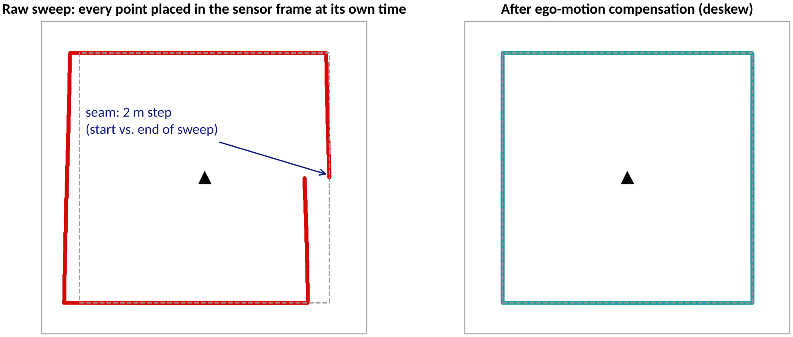
Motion Distortion and Deskewing
A spinning LiDAR needs ≈ 100 ms per 360° sweep (10 Hz)
At 20 m/s the car moves 2 m during one sweep
Each point carries its own timestamp; first and last points see different poses
Deskew: transform every point with the pose at its timestamp (IMU / odometry interpolation)
Ignoring it blurs walls and creates a seam at the start/end azimuth
Synthetic example: square room, ego speed 20 m/s along +x, sweep starts at azimuth 0°. The 2 m step appears where the sweep begins and ends.
Original figure (simulation).
Notes:
A spinning LiDAR needs a full revolution to collect a sweep. Ask students how far a car at 72 km/h travels in 100 ms (2 m). The left plot shows what happens if you ignore it: the start and end of the sweep disagree by 2 m, producing a seam. Deskewing uses the pose at each point's timestamp.

Slide 20
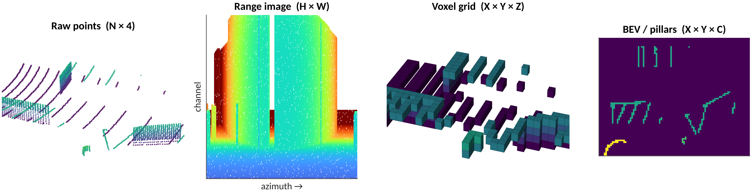
Four Ways to Represent a Sweep
 | Points | Range image | Voxels | Pillars / BEV
Structure | irregular set (N × 4) | 2D grid in (θ, φ) | regular 3D grid | 2D map from above
Strength | no information loss | dense, fast 2D CNNs | 3D locality, convolutions | cheap, scale-consistent
Weakness | needs set-based ops | scale varies, occlusion | mostly empty, memory | height is squashed
Original figure (same synthetic scene, crop x = 10–24 m, y = −9 to 2 m).
Notes:
Same scene crop in four representations. The choice of representation decides the network family: sets (PointNet), 2D CNN on range images, sparse 3D convolution on voxels, 2D CNN on a BEV pseudo-image (pillars). We return to each in Part 4.

Slide 21
Voxelization and Sparsity
Voxel grid: cut space into cubes of size v (0.1–0.4 m) and group points per cube
Region 80 m × 80 m × 4 m at v = 0.1 m → 800 × 800 × 40 = 25.6 M voxels
One sweep has ≈ 0.19 M points → < 1 % of voxels are non-empty
Dense 3D convolution spends > 99 % of its work on empty space
Remedies: sparse convolution (SECOND), pillars (no z split), range / BEV projection
Per-voxel features: mean (x, y, z), intensity, point count
25.6 M
voxels in an 80 × 80 × 4 m region (v = 0.1 m)
0.19 M
points in one 128-channel sweep
< 1 %
of voxels are occupied
Computed from the stated grid and the synthetic sweep (188,493 points).
Notes:
Worked example: 80 m x 80 m x 4 m region at 0.1 m resolution gives 25.6 million cells; one sweep has about 0.19 million points, so under 1% of voxels are occupied. This is why dense 3D convolution is wasteful and why sparse convolution and pillars were invented.

Slide 22
Open LiDAR Datasets
Dataset | Year | LiDAR | Scale | Notes
KITTI | 2012 | Velodyne HDL-64E, 10 Hz | 7,481 train / 7,518 test frames | Cars, pedestrians, cyclists; boxes in camera FOV
nuScenes | 2019 | 32-beam, 20 Hz (+ 6 cameras, 5 radars) | 1,000 scenes × 20 s; 1.4 M boxes; 23 classes | 360° annotations; Boston and Singapore
Waymo Open | 2019 | 5 LiDARs (1 mid-range, 4 short-range) | 1,150 scenes × 20 s (perception set) | High-density data; separate motion dataset
SemanticKITTI | 2019 | KITTI odometry sequences | Point-wise labels | Semantic segmentation benchmark
Tip: start with KITTI for debugging, then switch to nuScenes or Waymo Open for 360° evaluation.
Geiger et al. CVPR 2012; Caesar et al. CVPR 2020; Sun et al. CVPR 2020; Behley et al. ICCV 2019.
Notes:
Point students to these for the lab. KITTI is small and easy; nuScenes is 360-degree with 32-beam LiDAR; Waymo Open has 5 LiDARs and higher density. SemanticKITTI adds per-point labels to KITTI odometry sequences. Check each dataset's license before redistributing.

Slide 23
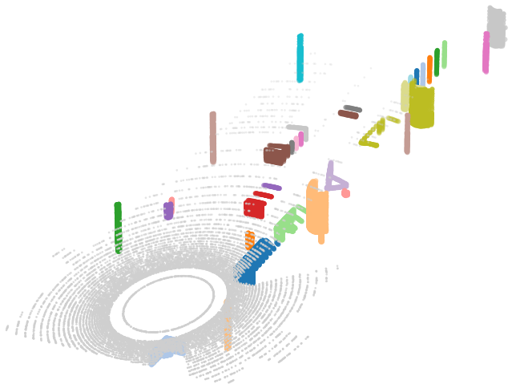
Part 3: Classical Point Cloud Perception
Pipeline | preprocessing | ground removal | clustering | boxes | ICP | tracking | limits
Notes:
Section divider. About 35 minutes for Part 3. All figures in this part are actual runs of the algorithms on the synthetic scene.

Slide 24
The Classical Perception Pipeline
Raw sweep
Preprocess
Ground removal
Clustering
Box fitting
Tracking
≈ 10⁵ points
10 Hz
crop, voxel
downsample, denoise
RANSAC plane or
ring-based
Euclidean /
DBSCAN
min-area rectangle,
PCA
Kalman filter +
association
• No training data: each stage has a few interpretable parameters (ε, thresholds, voxel size)
• Fast and explainable; runs on a CPU; easy to debug visually
• Still used as a baseline, a safety fallback, and a pre-labeling tool
• Output so far: a list of oriented 3D boxes, but no class and no understanding of context
• Open-source toolkits: Point Cloud Library (PCL) and Open3D
Typical structure used in early AV stacks; see also Khizbullin, LiDAR Perception for ADAS and AD (Module 3).
Notes:
Each stage is hand-designed with a few parameters. This is the pipeline many early AV stacks used, and it is still a useful baseline, fallback, and labeling aid. Libraries: PCL and Open3D.

Slide 25
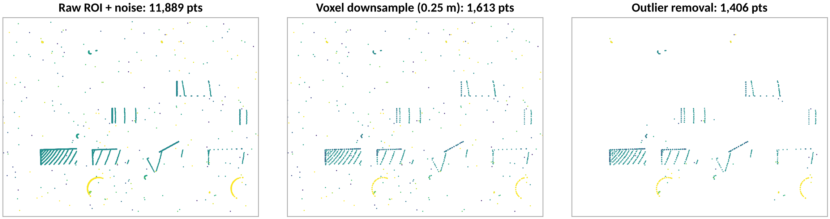
Step 1: Preprocessing
Crop to a region of interest (e.g., |y| < 12 m, z within the vehicle's height band)
Voxel-grid downsampling: one centroid per 0.25 m voxel, 11,889 → 1,613 points here (−86 %)
Statistical outlier removal: drop points whose mean neighbor distance exceeds μ + σ (k = 8), removing most injected noise
Parameter trade-off: coarser voxels are faster but erase small objects such as pedestrians and poles
Original figure: algorithms run on the synthetic scene (250 uniform noise points added).
Notes:
Voxel-grid downsampling replaces all points in a cell by their centroid, equalizing density. Statistical outlier removal drops points whose mean distance to k neighbors is above mean + sigma. In the figure, 250 random noise points were added to show the effect.

Slide 26
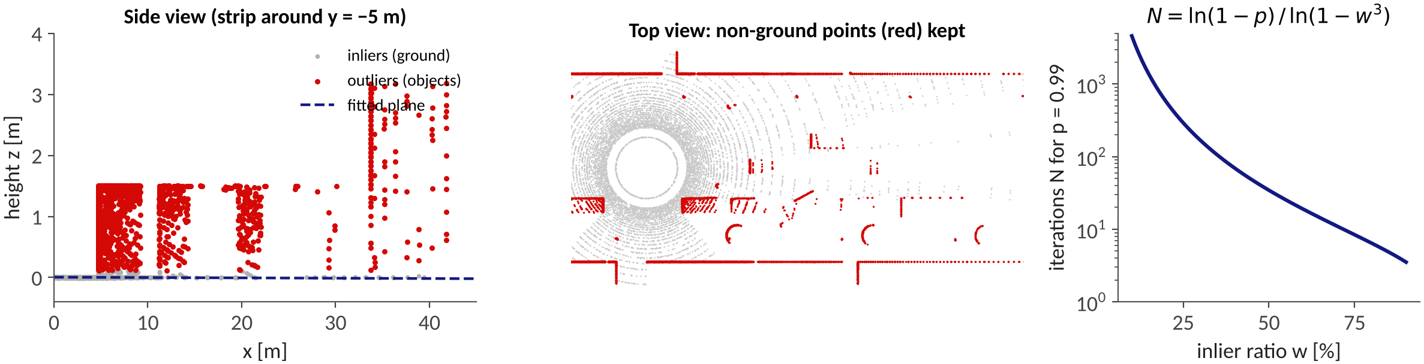
Step 2: Ground Removal with RANSAC
RANSAC: sample 3 low points → plane → count points within 0.12 m → keep the plane with most inliers
Sample only from low points (z < 0.5 m) so the fitted plane is the road, not a wall
Iterations N = ln(1−p) / ln(1−w³): inlier ratio w = 0.5, p = 0.99 → N ≈ 35
Real roads curve and slope: use zone-wise / ring-based fitting (e.g., Patchwork-style) instead of one global plane
Fischler and Bolles, Commun. ACM 1981. Original figure: RANSAC run on the synthetic scene.
Notes:
RANSAC: sample 3 points, fit a plane, count inliers within a threshold, repeat, keep the best. We sample from low points only; otherwise a wall can win. Iterations needed: N = ln(1-p)/ln(1-w^3); w = 0.5 and p = 0.99 give N = 35. Real roads are not planes, so production systems use zone-wise or ring-based fits.

Slide 27
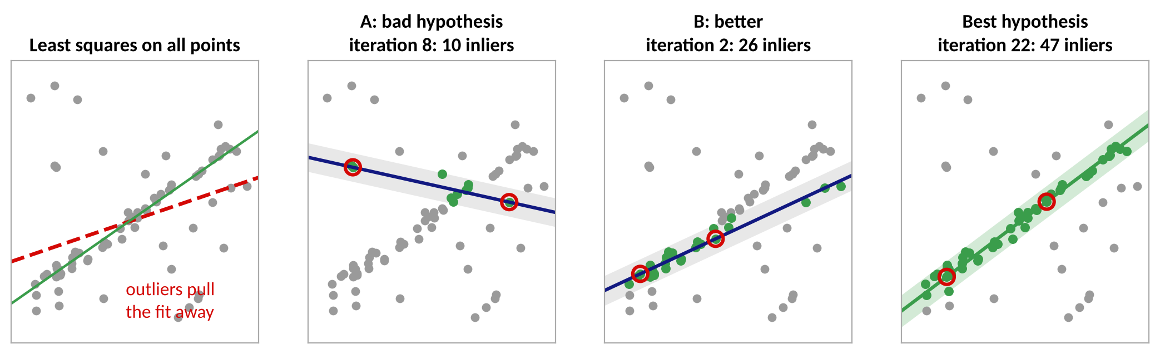
RANSAC: Fit Despite Outliers
Problem: least squares uses every point, so outliers (cars, walls, poles) bend the fit
Idea: guess a model from a minimal random sample, let all points vote, keep the model with the most inliers
A line needs 2 points; a plane (ground) needs 3 points; each guess is cheap to fit and to score
Inliers = points within threshold τ of the model (the shaded band); the last step refits on the inliers
Fischler and Bolles, Commun. ACM 1981. Original figure: 2D toy data (45 inliers, 25 outliers).
Notes:
Least squares minimises squared error over all points, so a few outliers drag the model away (left panel). RANSAC turns the problem around: propose a model from a minimal random sample, let every other point vote (inlier if within threshold tau), and keep the model with the most votes. The panels show three of 34 random hypotheses on a synthetic 2D line with 45 inliers and 25 outliers. Hypothesis A has 10 inliers, B has 26, and the best one (iteration 22) has 47. The red circles are the 2 sampled points. In the ground-removal step the same idea is used with 3 points and a plane.

Slide 28
RANSAC: Steps and Iterations
best = {}
repeat N times:
S = random sample of s points
model = fit(S) # s=3: a plane
I = {p : dist(p, model) < tau}
if |I| > |best|: best = I
model = least_squares_fit(best) # refit
return model, best
Inlier ratio w | N (line, s = 2) | N (plane, s = 3)
90% | 3 | 4
70% | 7 | 11
50% | 17 | 35
30% | 49 | 169
10% | 459 | 4,603
N = ln(1 − p) / ln(1 − w^s), confidence p = 0.99
τ (threshold): about 3σ of range noise plus road roughness; 0.1–0.2 m for ground planes
Low inlier ratio or large s makes N explode: use minimal samples and restrict candidates (z < 0.5 m)
Random, not deterministic: fix the seed in tests, stop early once enough inliers are found
Finds one model per run; to find several (e.g., two walls) remove the inliers and repeat
Fischler and Bolles, Commun. ACM 1981. Iteration counts computed from the formula.
Notes:
Walk through the pseudocode. The number of iterations N is chosen so that, with probability p, at least one sample contains only inliers: 1 - (1 - w^s)^N >= p, hence N = ln(1-p)/ln(1-w^s). The table uses p = 0.99. Note how quickly N grows when the inlier ratio w drops and when the sample size s grows, which is why RANSAC prefers minimal samples. For the road, inliers are typically 30 to 60 percent of the low points, so a few dozen to a few hundred iterations suffice. Practical tips: threshold about 3 sigma of range noise plus road roughness (0.1 to 0.2 m); sample only from low points; stop early when the inlier count is high enough; refit with SVD on the inliers.

Slide 29
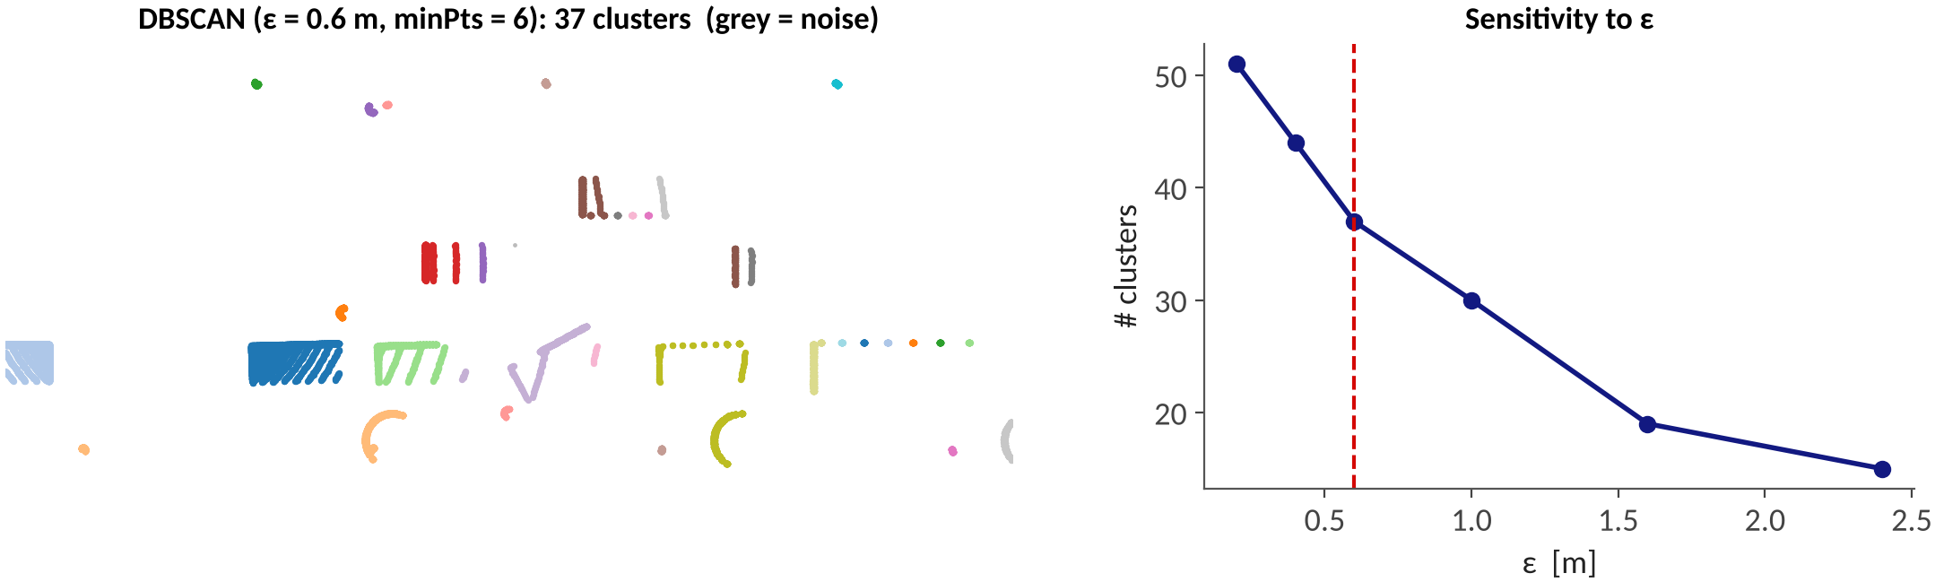
Step 3: Clustering Objects
Euclidean clustering / DBSCAN: connect points closer than ε, grow clusters with a KD-tree; points in sparse regions become noise
Here ε = 0.6 m and minPts = 6 give 37 clusters (cars, pedestrians, poles, trees, wall pieces)
ε is a trade-off: too small splits objects, too large merges neighbors (right plot)
Far objects are sparser (slide 9): use a range-dependent ε(R)
Ester et al., KDD 1996 (DBSCAN). Original figure: scikit-learn DBSCAN on the synthetic scene.
Notes:
Euclidean clustering and DBSCAN both group points that are chained by neighbors within eps. DBSCAN adds a minimum neighbor count and marks isolated points as noise. Right plot: the number of clusters drops as eps grows because objects merge. A fixed eps is wrong at long range because point spacing grows with R (see slide 9).

Slide 30
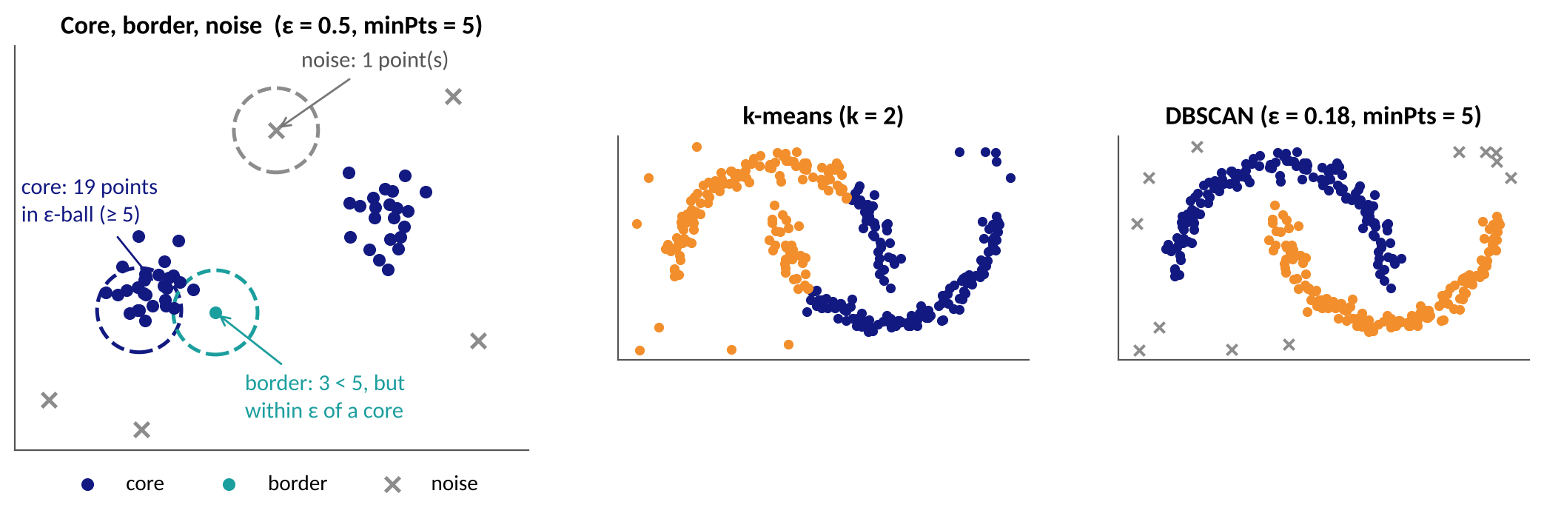
DBSCAN: Core, Border, Noise
Core point: at least minPts points within distance ε; border: fewer, but within ε of a core; noise: neither
A cluster grows by chaining overlapping ε-balls of core points, so it can take any shape
No need to choose the number of clusters, and sparse noise is rejected (k-means assigns every point)
Ester et al., KDD 1996. Original figures: toy data and scikit-learn make_moons (300 points + 12 outliers).
Notes:
DBSCAN has two parameters: the radius epsilon and the minimum number of points minPts within that radius. A point is a CORE point if its epsilon-ball contains at least minPts points (itself included). A BORDER point has fewer neighbors but lies within epsilon of a core point. Everything else is NOISE. A cluster is a maximal set of core points connected through overlapping epsilon-balls, plus their border points. Left: toy example with eps = 0.5, minPts = 5. Right: k-means must be told k and cuts the two crescents with a straight boundary; DBSCAN follows the density and also flags the 12 scattered points as noise. For LiDAR this matters because we do not know how many objects are in a frame, and isolated returns (rain, dust, stray points) should not form clusters.

Slide 31
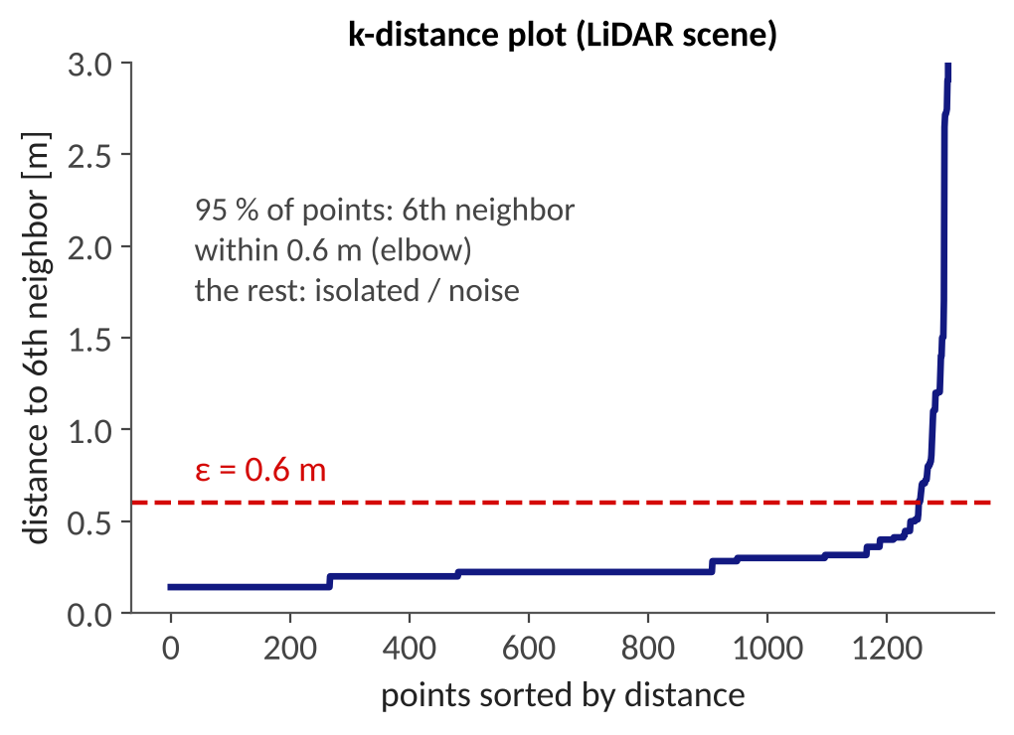
DBSCAN: Choosing ε and minPts
for each unvisited point p:
mark p visited; N = neighbors(p, ε)
if |N| < minPts: label p noise; continue
new cluster C; add p to C
for each q in N: # queue
if q unvisited:
mark q visited
N' = neighbors(q, ε)
if |N'| >= minPts: N = N + N'
if q in no cluster: add q to C
minPts ≈ 4–6 for 2D (top-view) clustering; ε at the elbow of the k-distance plot (here ≈ 0.6 m)
KD-tree neighbor queries give O(n log n): downsample (0.1 m voxels) before clustering
Point spacing s = R·tan Δθ grows with range (0.07 m at 20 m, 0.21 m at 60 m for 0.2°): one ε does not fit near and far
Remedies: range-adaptive ε(R), clustering on the range image, or HDBSCAN
Ester et al., KDD 1996. Original figure: k-distance of the synthetic scene (1,316 voxel centers, k = 6).
Notes:
Pseudocode: visit each unvisited point, query its epsilon-neighborhood with a KD-tree, and if it is a core point, expand a cluster by a breadth-first search. Complexity is O(n log n) with a spatial index, which is why we downsample first. Choosing parameters: minPts around 4 to 6 for 2D clustering; epsilon from the k-distance plot, where each point's distance to its k-th neighbor is sorted and the elbow separates dense points from noise. On the 0.1 m voxel-downsampled non-ground points of our scene, 95 percent of points have their 6th neighbor within 0.6 m and the curve then shoots up. LiDAR specific: point spacing grows with range, s = R tan(delta theta). With 0.2 degree horizontal resolution it is 0.07 m at 20 m and 0.21 m at 60 m; the vertical gap at 0.5 degrees is 0.17 m and 0.52 m. A single epsilon therefore either merges near objects or shatters far ones. Fixes: range-adaptive epsilon, clustering in the range image, or HDBSCAN.

Slide 32
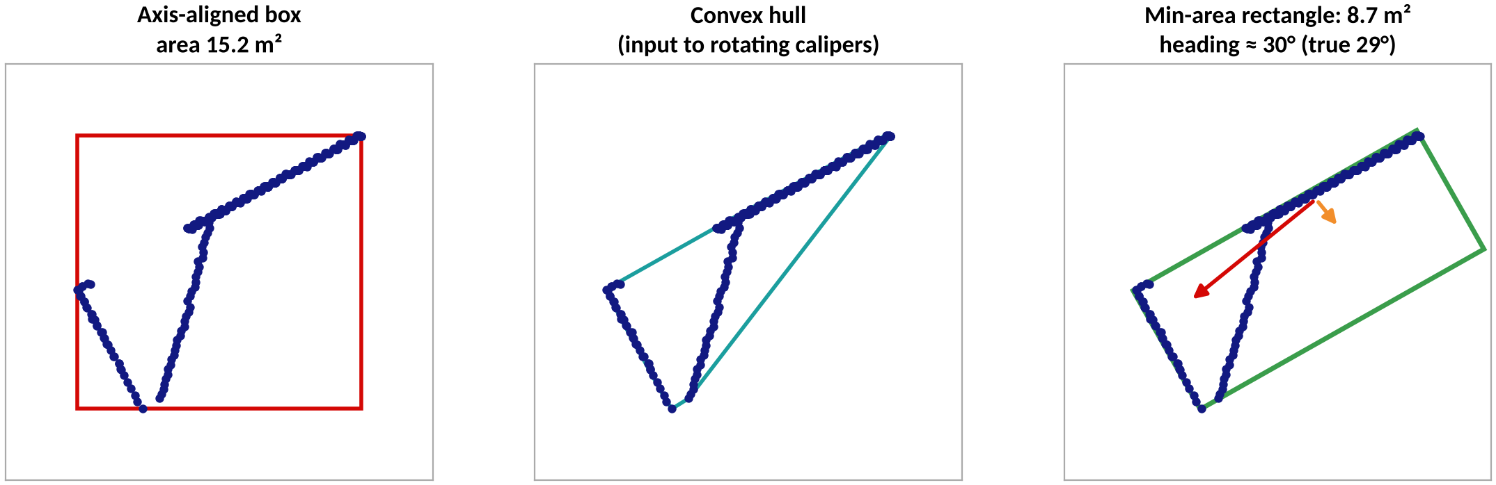
Step 4: Fitting an Oriented Box
An axis-aligned box over-estimates a rotated car: 15.2 m² vs. 8.7 m² for the min-area rectangle
Min-area rectangle: try headings 0–90°, keep the smallest enclosing rectangle (or rotating calipers on the convex hull)
PCA gives a quick heading; L-shape fitting uses the two visible faces of a car
Recovered heading ≈ 30° vs. true 29°; box height from the z-extent, center z from the ground plane
Original figure: parked car rotated by 29° in the synthetic scene.
Notes:
An axis-aligned box over-estimates the footprint of a rotated car (15.2 square meters here vs 8.7). Search headings between 0 and 90 degrees and keep the smallest-area rectangle, or use rotating calipers on the convex hull. The recovered heading is 30 degrees against a true 29 degrees. Height comes from the z-range.

Slide 33
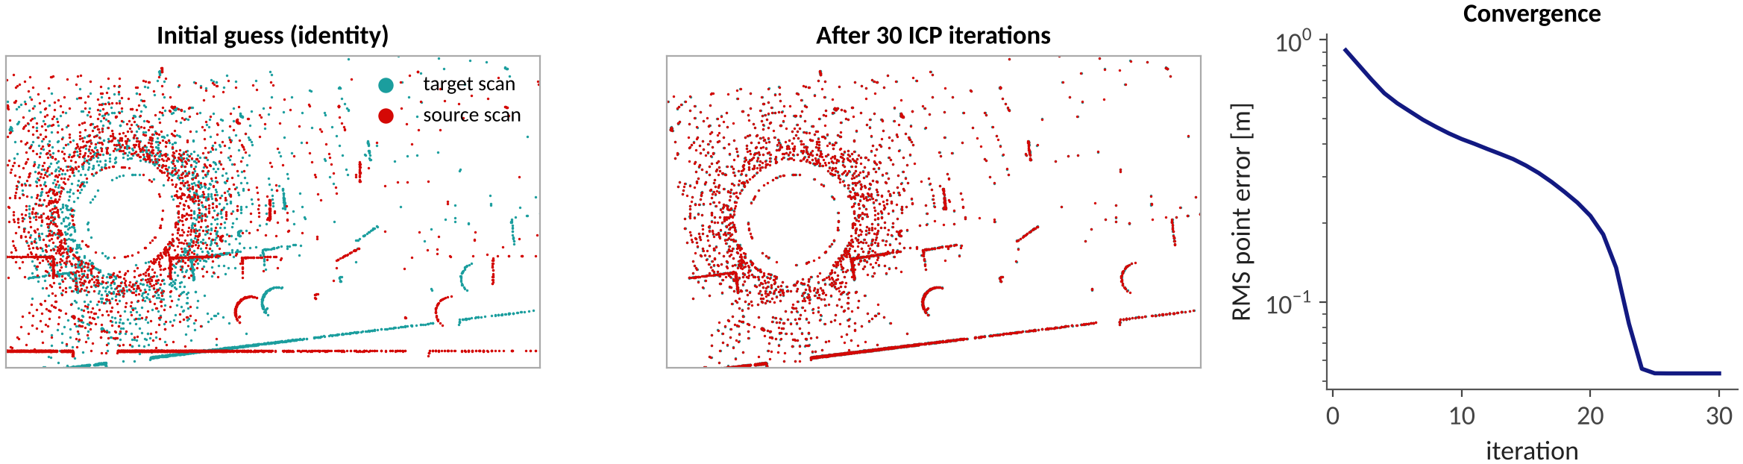
Registration with ICP
Align scan B to scan A: minimize Σ ‖R pᵢ + t − qᵢ‖² over matched pairs
Loop: nearest-neighbor matching (KD-tree) → closed-form (R, t) by SVD → apply → repeat
Needs a good initial guess (odometry): otherwise it converges to a local minimum
Variants: point-to-plane, NDT, GICP; LOAM matches edge and plane features. Uses: odometry, mapping, localization
Here (synthetic, 7° and 1.4 m offset): RMS error 0.91 m → 0.05 m in 30 iterations
Besl and McKay, IEEE TPAMI 1992; Zhang and Singh, RSS 2014 (LOAM). Original figure.
Notes:
ICP aligns two scans: find nearest neighbours, solve the best rigid transform in closed form by SVD, apply, repeat. It needs a good initial guess and converges to a local minimum. Here scan B is scan A rotated by 7 degrees and shifted by (1.4, -0.7) m with noise and dropout; after 30 iterations the RMS error falls from 0.91 m to 0.05 m.

Slide 34
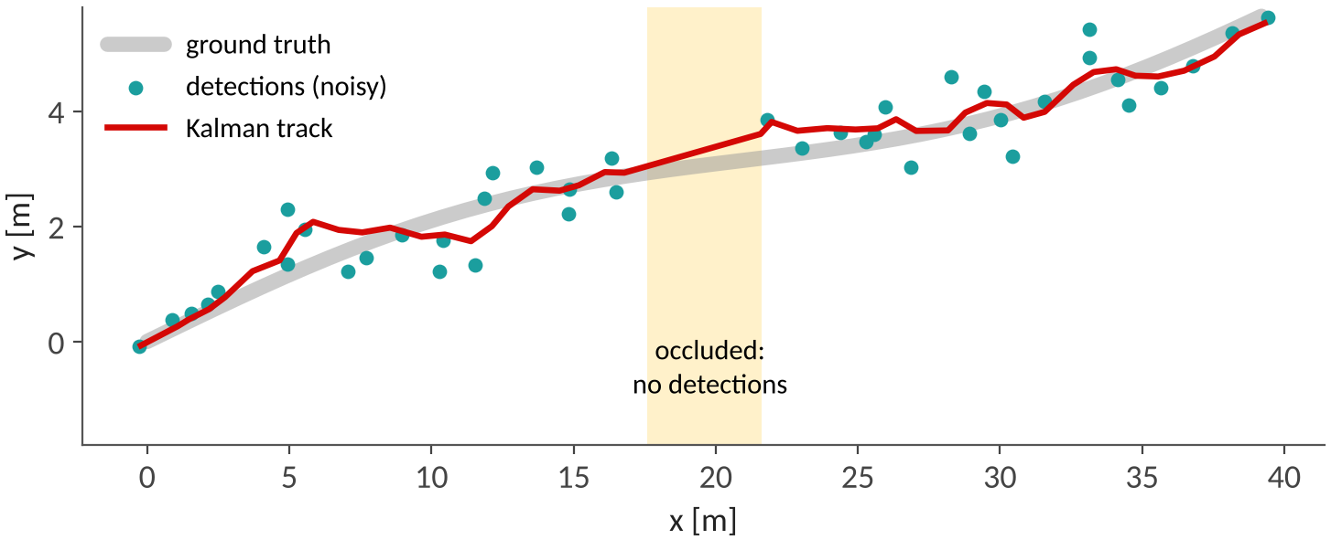
Step 5: Tracking with a Kalman Filter
Associate detections with tracks (nearest neighbor or Hungarian algorithm on distance / IoU)
Kalman filter, state [x, y, vₓ, v_y]: predict with constant velocity, update with the detection
Prediction carries the track through an occlusion (here 0.6 s without detections)
Track management: birth, confirmation, deletion
Predict: x̂ = F x, P = F P Fᵀ + Q
Update: K = P Hᵀ (H P Hᵀ + R)⁻¹, x = x̂ + K (z − H x̂)
Here: RMS error 0.66 m (raw detections) → 0.37 m (filtered)
Kalman, 1960; Kuhn, 1955 (Hungarian algorithm). Original figure (simulation, detection noise σ = 0.45 m).
Notes:
State is position and velocity; predict with constant velocity, update when a detection is associated. During occlusion the filter keeps predicting. Association uses nearest neighbour or the Hungarian algorithm on a cost such as distance or IoU. In this simulation, detections have 0.45 m noise; RMS error drops from 0.66 m to 0.37 m.

Slide 35
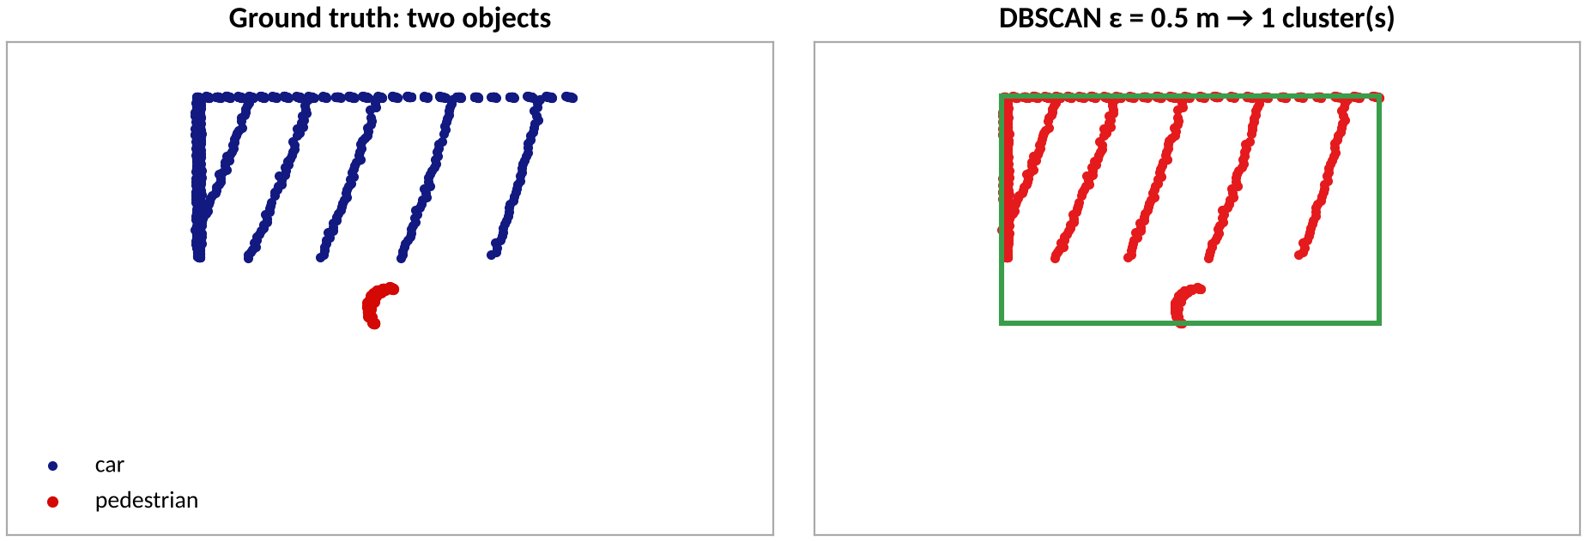
Where the Classical Pipeline Breaks
Under-segmentation: pedestrian 0.3 m from a car → one cluster (2,077 + 109 points)
Over-segmentation: far objects split into fragments
No semantics: cannot tell a car from a bush
Thresholds need re-tuning per scene and sensor
→ Learned detectors use context and appearance to separate and classify objects
→ Classical stages remain valuable as fallbacks, for labeling tools, and for sanity checks on network outputs
Original figure: DBSCAN (ε = 0.5 m) on a second synthetic scene with a pedestrian next to a car.
Notes:
Under-segmentation example: a pedestrian standing 0.3 m from a parked car is merged into one cluster by DBSCAN with eps = 0.5 m (car 2,077 points, pedestrian 109). This is the bridge to learning: networks use context and appearance to separate and classify objects.

Slide 36
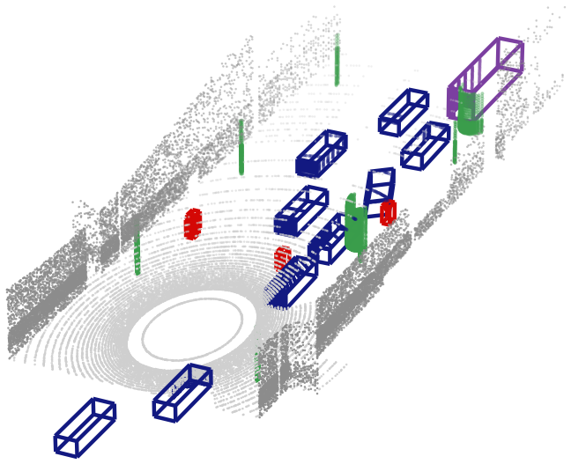
Part 4: Deep Learning Perception
Tasks | PointNet | voxels | pillars | BEV | metrics | fusion | Waymo | latency and robustness
Notes:
Section divider. About 40 minutes for Part 4.

Slide 37
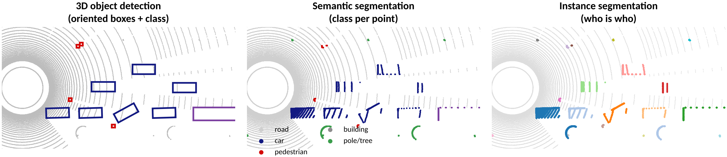
Perception Tasks on Point Clouds
3D object detection (our focus): oriented box (x, y, z, l, w, h, θ) + class + confidence for every object
Semantic segmentation: a class label per point (e.g., SemanticKITTI); instance segmentation adds object identity
Tracking and motion forecasting consume the detections over time
Supervision: human-labeled 3D boxes or per-point labels; auto-labeling is increasingly used
Original figure: ground-truth labels of the synthetic scene.
Notes:
Three tasks on the same input. 3D detection outputs oriented boxes with class and score; semantic segmentation assigns a class per point; instance segmentation adds object identity. Tracking and prediction build on detection. The panels show ground-truth labels of the synthetic scene.

Slide 38
Why Point Clouds Are Hard to Learn
Unordered
Sparse and non-uniform
N points can be listed in N! orders; the output must not change
Remedy: symmetric functions (max-pool), as in PointNet
Density falls ≈ 1/R²; far objects have only a handful of points
Remedy: sparse convolution, learned features, larger receptive fields
Large scale
No regular grid
≈ 10⁵ points per sweep and a ≈ 100 ms budget at 10 Hz
Remedy: voxel / pillar grids, range images, efficient 2D backbones
No neighbors and no pixels: standard CNNs do not apply directly
Remedy: voxelize or project to a grid, or use point-based set operators
See Qi et al., CVPR 2017; Zhou and Tuzel, CVPR 2018; Lang et al., CVPR 2019.
Notes:
Four properties, four remedies. This slide is the map for the next five: PointNet (symmetric functions), voxels and pillars (regular grids), range images (projection), and BEV.

Slide 39
PointNet: Learning on Raw Points
Input
n × 3 points
Shared MLP
(64, 64)
Shared MLP
(64, 128, 1024)
Max pool
over points
Global feature
1024-d
MLP
(512, 256, k)
per point (weights shared across points)
per cloud → class scores (k classes)
• f({x₁…xₙ}) ≈ γ( MAX ᵢ h(xᵢ) ): h is shared per point and max-pool is symmetric, so the output is order-invariant
• A small T-Net predicts a transform that aligns the input (pose normalization)
• For segmentation, concatenate the global feature with each per-point feature
• Limitation: no local neighborhoods → PointNet++ adds hierarchical sampling and grouping
• Cost: neighbor search and sampling are slow on 10⁵ points per sweep, so detectors moved to grids
Qi, Su, Mo, Guibas, CVPR 2017 (PointNet); Qi et al., NeurIPS 2017 (PointNet++).
Notes:
PointNet applies the same MLP to every point, then a max-pool over points, which is a symmetric function: reordering the points cannot change the result. Segmentation concatenates the global feature to each point feature. Limitation: no local neighborhoods; PointNet++ adds hierarchical sampling and grouping.

Slide 40
Voxel Detectors: VoxelNet and SECOND
Point cloud
Voxelize
(group points)
Voxel feature
encoder (PointNet)
3D convolutions
(sparse in SECOND)
Flatten to BEV
(stack z)
2D head
boxes + scores
• VoxelNet (2018): first end-to-end voxel detector; per-voxel PointNet features + dense 3D convolution, but slow and memory-hungry
• SECOND (2018): sparse 3D convolution only touches non-empty voxels (< 1 % of the grid, slide 21) → much faster
• SECOND also popularized ground-truth sampling: paste labeled objects from other scenes into the current one
• Strong accuracy, but needs custom sparse-conv kernels → harder to deploy on embedded GPUs
Zhou and Tuzel, CVPR 2018 (VoxelNet); Yan, Mao, Li, Sensors 2018 (SECOND).
Notes:
VoxelNet groups points into voxels, encodes each voxel with a small PointNet (VFE), runs 3D convolutions, then collapses to a BEV map for a region proposal network. SECOND replaces dense 3D convolution by sparse convolution that only computes on non-empty voxels, making it much faster, and popularized ground-truth sampling augmentation.

Slide 41
PointPillars: Pillars + 2D CNN
Point cloud
Pillars on x–y grid
(P, N, D) = (12000, 100, 9)
Pillar feature net
(mini PointNet)
Scatter to
pseudo-image C × H × W
2D CNN
backbone
SSD head
boxes + class
• Pillars drop the z split → only 2D convolutions: simple to deploy (e.g., TensorRT) and fast, 62 Hz in the paper
• Point decoration: x, y, z, intensity + offsets to pillar mean (3) and pillar center (2) → D = 9
• Fixed buffers: ≤ P = 12,000 non-empty pillars and ≤ N = 100 points per pillar (extra points are sampled away)
• Trade-off: vertical structure inside a pillar is only captured by learned features
• A good default for real-time systems and a common baseline in toolboxes such as OpenPCDet
Lang et al., CVPR 2019 (PointPillars).
Notes:
Pillars are voxels with unlimited height, so there is no 3D convolution at all. Each point is decorated with offsets to the pillar mean and center (D = 9). A small PointNet turns each pillar into a vector, which is scattered back to the grid as a pseudo-image processed by a standard 2D backbone and an SSD-style head. The paper reports 62 Hz.

Slide 42
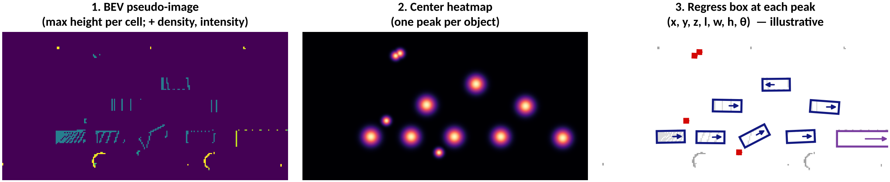
BEV Features and Center-Based Detection
BEV (bird's-eye view): objects do not overlap, size does not change with distance, and it matches the planning space
CenterPoint: predict a heatmap peak at each object center, then regress size, height, heading (sin, cos), and velocity
Anchor-free: no anchor boxes; tracking by matching center offsets between frames
Waymo (ISSW 2024): BEV aggregation improves generalization and supports plan validation
Yin, Zhou, Krähenbühl, CVPR 2021 (CenterPoint); Waymo, ISSW 2024. Original figure; right panel illustrative.
Notes:
Left: BEV pseudo-image built from max height per cell. Middle: a center heatmap with one peak per object (built from the ground-truth centers). Right: boxes regressed at each peak. The right panel is illustrative: boxes are the ground truth plus small random noise, not a trained model's output.

Slide 43
Comparing Detector Families
Family | Representation | Examples | Strengths | Weaknesses
Point-based | raw points | PointNet++, PointRCNN | fine geometry | slow neighbor search at scale
Range-view | range image | LaserNet, RangeNet++ | fast 2D CNNs | scale varies; occlusion
Voxel | 3D grid + sparse conv | VoxelNet, SECOND | accurate | memory; custom ops
Pillar / BEV | 2D pseudo-image | PointPillars, CenterPoint | fast, easy to deploy | height is squashed
Point–voxel | hybrid | PV-RCNN | fine + coarse features | complex two-stage pipeline
Sparse transformer | sparse windows | SWFormer (Waymo) | long-range context | newer, compute-heavy
Qi et al. 2017; Meyer et al., CVPR 2019 (LaserNet); Milioto et al., IROS 2019; Shi et al., CVPR 2020 (PV-RCNN); Sun et al., ECCV 2022 (SWFormer).
Notes:
Use this table as the summary of Part 4 so far. No single winner: point-based methods keep fine geometry but scale poorly; pillars are the easiest to deploy; transformers over sparse windows (SWFormer) bring long-range context and are used at Waymo scale.

Slide 44
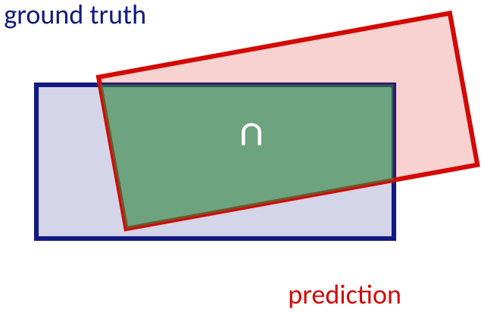
How Detections Are Scored
IoU = |A ∩ B| / |A ∪ B|
KITTI: true positive if IoU ≥ 0.7 (car), ≥ 0.5 (pedestrian, cyclist); AP over the precision–recall curve
nuScenes: match by center distance (0.5, 1, 2, 4 m) → mAP; NDS adds box, attribute, velocity errors
Waymo: AP and heading-weighted APH, with L1 / L2 difficulty levels
Small objects: a 0.3 m shift can cut IoU sharply
Example: 4.4 m × 1.9 m boxes, 0.9 m shift and 10° heading error → BEV IoU = 0.45
Geiger et al. 2012; Caesar et al. 2020; Sun et al. 2020. IoU example computed on the figure's boxes (polygon clipping).
Notes:
IoU is the overlap between predicted and ground-truth boxes. A detection counts as true positive if IoU exceeds a class-specific threshold; AP is the area under the precision-recall curve. In the example the BEV IoU is 0.45 even though the boxes look close: small objects are very sensitive to localization error. nuScenes uses center distance instead of IoU.

Slide 45
LiDAR–Camera Fusion
Early fusion
Feature-level (BEV) fusion
Late fusion
Image
segmentation
Camera and LiDAR
backbones
Camera detector +
LiDAR detector
Project points,
append class scores
Fuse features
in a shared BEV map
Associate and
merge boxes
LiDAR detector
Detection head
Final detections
e.g., PointPainting
e.g., BEVFusion
e.g., decision level
Why fuse: LiDAR = geometry, camera = color and texture. Requirements: precise extrinsics and time synchronization.
Vora et al., CVPR 2020 (PointPainting); Liu et al., ICRA 2023 (BEVFusion).
Notes:
LiDAR gives precise geometry; the camera gives color, texture, and long-range cues. Three levels of fusion: early (paint points with image semantics), feature level (BEVFusion fuses both in a shared BEV space), and late (merge boxes). Fusion needs precise calibration and time synchronization.

Slide 46
Case Study: Waymo's LiDAR Perception
Sensors
4 short-range + long-range
360° LiDAR, cameras, radar
BEV features
sparse point clouds
3D detection
(SWFormer)
Tracking and
motion prediction
Planning
• Processes O(10) sensors with hundreds of millions of readings per second; decisions at ≥ 10 Hz
• SWFormer (sparse window transformer): dense convolution grows quadratically with range, sparse convolution is awkward on TPUs
• Waymo Open Dataset is a public benchmark with camera + LiDAR and rich 3D labels
• Offboard auto-labeling with object-centric pipelines produces labels at scale
• Vision-language models transfer concepts such as 'bulldozer' or 'firetruck' to 3D detectors without 3D labels
• Reported: detection beyond 200 m at night on freeways
Waymo (S. Verghese), 'Lidar and Autonomous Cars', ISSW 2024; Sun et al., ECCV 2022 (SWFormer).
Notes:
Summarize the ISSW 2024 talk by S. Verghese. System-level view: hardware (SPAD detectors, laser diodes) and ML co-designed. SWFormer processes sparse point clouds with windowed attention; the dense conv cost grows quadratically with range and sparse conv is awkward on TPUs. Auto-labeling and vision-language models reduce the need for 3D labels.

Slide 47
Latency and Robustness
Distance = speed × latency: 100 ms at 60 m/s closing speed = 6 m
Worst-case latency matters for safety, not just the average
Levers: pillars / 2D CNNs, sparse ops, ROI cropping, FP16 / INT8 (TensorRT)
Adversarial LiDAR attacks: spoofed pulses inject points; Cao et al. (2019) made a LiDAR detector (Apollo) see a non-existent obstacle
Defenses: sensor fusion, consistency checks, adversarial training
Computed (d = v·t). Cao et al., ACM CCS 2019; Utah CS7960 lecture slides on self-driving cars.
Notes:
Distance traveled during latency = v x t. At 60 m/s relative speed (two cars at 30 m/s head-on), 100 ms is 6 m. The Utah slides stress worst-case rather than average latency. Robustness: spoofed laser pulses can inject points; Cao et al. (CCS 2019) showed adversarially optimized spoofing could make a LiDAR detector (Baidu Apollo) perceive a non-existent obstacle. Link to the adversarial attacks lecture.

Slide 48
Lab and Discussion
Hands-on lab
Discussion questions
1. Load a KITTI or nuScenes sweep with Open3D
2. Implement RANSAC ground removal + DBSCAN and draw oriented boxes
3. Run a pretrained PointPillars (OpenPCDet or MMDetection3D)
4. Compare both on cars: precision and recall at IoU 0.5
5. Plot detections vs. range: where does each method fail?
1. Why is a pedestrian at 100 m hard for a 0.2° LiDAR?
2. When would classical clustering beat a neural network?
3. What goes wrong if the extrinsic calibration is off by 0.5°?
4. Pillars or voxels: which would you deploy on a vehicle GPU, and why?
5. Which sensor failure in slide 14 is hardest to fix in software?
Tools: Open3D, OpenPCDet, MMDetection3D (open source).
Notes:
Suggested lab (about 45 minutes): Open3D for the classical pipeline on a KITTI frame, then a pretrained PointPillars from OpenPCDet or MMDetection3D. Discussion questions can be used as a short quiz or exit ticket.

Slide 49
Summary and Further Resources
Key takeaways
Further resources
• A LiDAR measures time of flight; spacing, weather, and reflectivity set what you see
• Point clouds are unordered, sparse, range-dependent and need correct frames and deskewing
• Classical pipelines (ground → clusters → boxes → tracks) are fast but brittle
• Deep detectors trade representation for speed: points, voxels, pillars, BEV
• Always evaluate with IoU-based AP and consider latency and robustness
• Khizbullin: LiDAR Perception for ADAS and AD (GitHub; Modules 3–4, Google Slides)
• Waymo, Lidar and Autonomous Cars (ISSW 2024, PDF)
• Univ. Tübingen: Self-Driving Cars, L10.5 3D Object Detection
• Univ. Utah: CS7960 self-driving cars lecture (latency and safety)
• OpenPCDet and MMDetection3D: reference implementations
Links are listed on the next slide.
Notes:
Recap in one minute: measure (ToF), represent (points, grids), process (classical or learned), evaluate (IoU, AP). Resources are listed for self-study; the Khizbullin modules are Google Slides, so they are for reading rather than for reuse.

Slide 50
References
[1] S. Verghese (Waymo), Lidar and Autonomous Cars, ISSW 2024. imagesensors.org/Past Workshops/2024 ISSW/Presentations/R05-1.pdf
[2] A. Geiger, P. Lenz, R. Urtasun, KITTI, CVPR 2012.
[3] H. Caesar et al., nuScenes, CVPR 2020.
[4] P. Sun et al., Waymo Open Dataset, CVPR 2020.
[5] J. Behley et al., SemanticKITTI, ICCV 2019.
[6] M. Fischler, R. Bolles, RANSAC, Commun. ACM 1981.
[7] M. Ester et al., DBSCAN, KDD 1996.
[8] P. Besl, N. McKay, A method for registration of 3-D shapes, TPAMI 1992.
[9] J. Zhang, S. Singh, LOAM, RSS 2014.
[10] C. Qi et al., PointNet, CVPR 2017; PointNet++, NeurIPS 2017.
[11] Y. Zhou, O. Tuzel, VoxelNet, CVPR 2018.
[12] Y. Yan, Y. Mao, B. Li, SECOND, Sensors 2018.
[13] A. Lang et al., PointPillars, CVPR 2019.
[14] T. Yin, X. Zhou, P. Krähenbühl, CenterPoint, CVPR 2021.
[15] S. Shi et al., PV-RCNN, CVPR 2020.
[16] P. Sun et al., SWFormer, ECCV 2022.
[17] S. Vora et al., PointPainting, CVPR 2020; Z. Liu et al., BEVFusion, ICRA 2023.
[18] Y. Cao et al., Adversarial sensor attack on LiDAR-based perception, ACM CCS 2019.
[19] D. Khizbullin, LiDAR Perception for ADAS and AD, github.com/dmitrii-khizbullin/lidar_course
[20] Univ. Tübingen Self-Driving Cars (A. Geiger); Univ. Utah CS7960 self-driving cars lecture.
Notes:
Full reference list. Please check each dataset and slide deck's license before reusing material in public course pages.

